Slide 1





BRACT'S VISHWAKARMA INSTITUTE OF INFORMATION TECHNOLOGY
Detection of face-swap-based deepfake images
Guided by: Dr. Anuradha Yenkikar Ma'am
Presented By Group no A33:
Roll no.: | PRN: | Name:
281059 | 22311746 | Dev Bhangale
281060 | 22311748 | Prachee Prasad
281069 | 22420090 | Aziz Sayyad
281072 | 22420145 | Vivek Mule
SY A3, Department of CSE (AI)

Slide 2


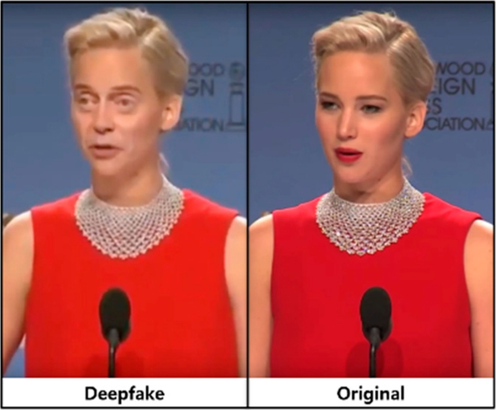


Problem Statement
With the rise of AI-generated deepfake images, distinguishing real from fake has become increasingly challenging. Existing detection methods often lack accuracy and they function as black-box models, lacking interpretability, making it difficult to understand what makes an image classify as real or fake.
Objectives
1. Develop an accurate model to detect deepfake images.
2. Strengthen security by flagging deceptive content.
3. Leverage explainable AI techniques (Integrated Gradients) to provide transparency in detection decisions.
4. Optimize detection by evaluating multiple models.
5. Improve precision to minimize false positives and negatives.

Slide 3





Literature Survey
Sr. No. | Title | Author | Summary
1 | DeepFake Detection using InceptionResNetV2 and LSTM | P. Yadav, Ishani Jaswal, Jaiprakash Maravi, Vibhash Choudhary, G. Khanna | Uses InceptionResNetV2 and LSTM for deepfake detection, achieving 91.48% accuracy with 40 epochs.
2 | Comparative Analysis and Evaluation of CNN Models for Deepfake Detection | Pattrick Ritter, Devan Lucian, Andry Chowanda | Tests ResNet-152, MobilenetV3, Convnext, and EfficientNetB7, with EfficientNetB7 reaching 75% accuracy.
3 | Comparative Analysis of Deepfake Detection Models | Om Jannu, Vendra Sekar, Tushar Padhy, Prasad Padalkar | Evaluates Xception, ResNet50, and Swin Transformer, highlighting Xception and ResNet50's high accuracy.
Dataset: https://www.kaggle.com/datasets/manjilkarki/deepfake-and-real-images

Slide 4
Literature Survey
Sr. No. | Title | Author | Summary
4 | DeepFake Detection using Deep Neural Networks | Ambuj Agnihotri | Achieves 98% accuracy using EfficientNetB4-LSTM on the FFHQ dataset.
5 | An Approach for Copy-Move and Image Splicing Forgery Detection using Automated Deep Learning | Krishna H. Hingrajiya, Chintan Patel | DenseNet-201 model detects image forgeries with 94.12% accuracy.
6 | Deep Fake Detection and Classification using Error-Level Analysis and Deep Learning | Rimsha Rafique, Rahma Gantassi, Rashid Amin, Jaroslav Frnda, Aida Mustapha, A. Alshehri | Combines CNN with SVM/KNN for 89.5% accuracy in deepfake detection.
Dataset: https://www.kaggle.com/datasets/manjilkarki/deepfake-and-real-images

Slide 5


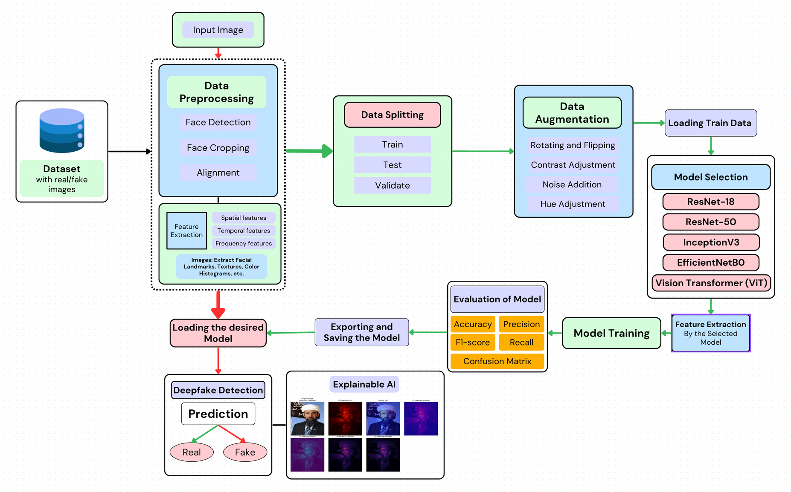

System Architecture Diagram
Fig 1 - Architecture Diagram

Slide 6
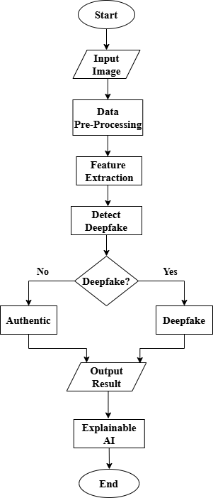



Proposed Methodology
Image Preprocessing
We acquired a dataset containing real and deepfake images (100,000+ images).
Each image was resized to a fixed dimension for consistency.
Pixel values were normalized to the [0,1] range to enhance model efficiency.
Data augmentation techniques (flipping, rotation, contrast adjustments) were applied to improve generalization.

Slide 7


Proposed Methodology
2. Model Training & Comparison
We trained multiple deep learning models for deepfake detection: ResNet-18, ResNet-50, Vision Transformer (ViT), EfficientNet, Custom CNN, and InceptionNet.
Each model was trained using a binary classification approach (Real vs. Deepfake).
We used BCEWithLogitsLoss as the loss function and Adam optimizer for stable convergence.
Hyperparameter tuning was performed to optimize learning rate, batch size, and dropout rates.
After training, we compared models based on accuracy, precision, recall, F1-score, ROC and AUC to determine the best-performing architecture.

Slide 8

Proposed Methodology
3. Explainable AI (XAI) Integration
To improve transparency, we implemented Integrated Gradients for model interpretability.
Heatmaps were generated to visualize the image regions that influenced the model’s predictions.
Different colormaps (jet, plasma, viridis, etc.) were applied for clearer insights.
This step ensured that the model focused on relevant features rather than artifacts, improving trust and reliability.

Slide 9


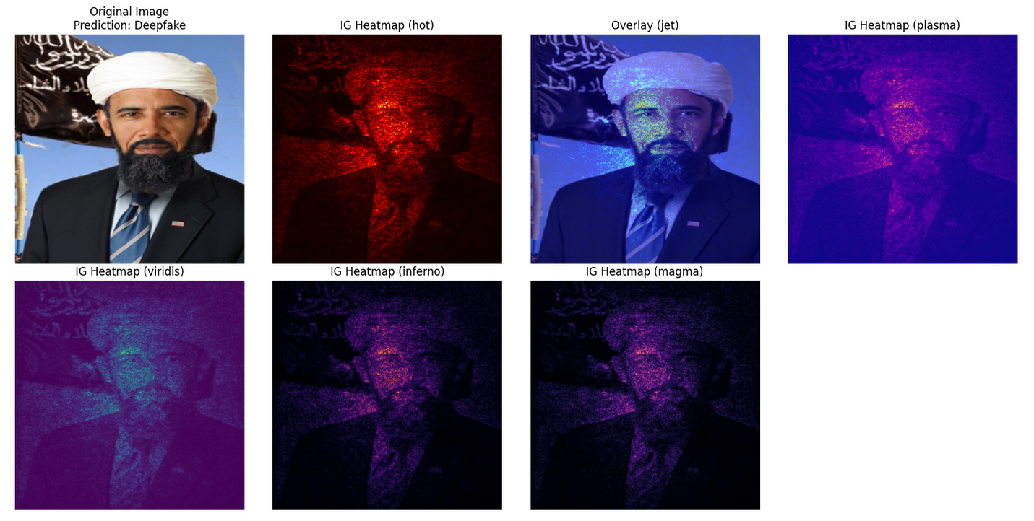

Our Unique Approach
Explainable AI (XAI)
Deepfake detection models often act as black boxes, making it difficult to understand their decisions.
To improve trust and transparency, we integrated Explainable AI (XAI) using Integrated Gradients.
It will help us to validate whether the model focused on meaningful patterns rather than irrelevant noise.
Fig 3. Integrated Gradients Example

Slide 10








Tech Stack
Explainable AI

Slide 11
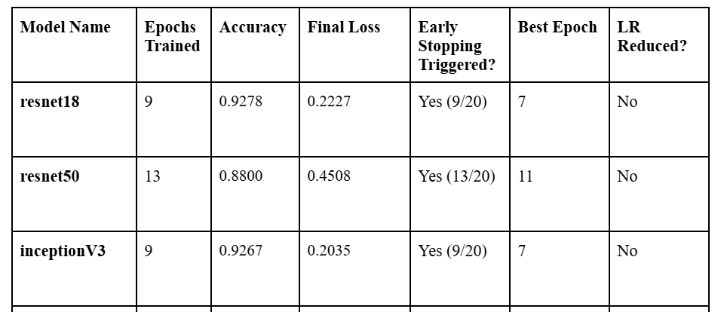
RESULTS
Without Data Augmentation:

Slide 12
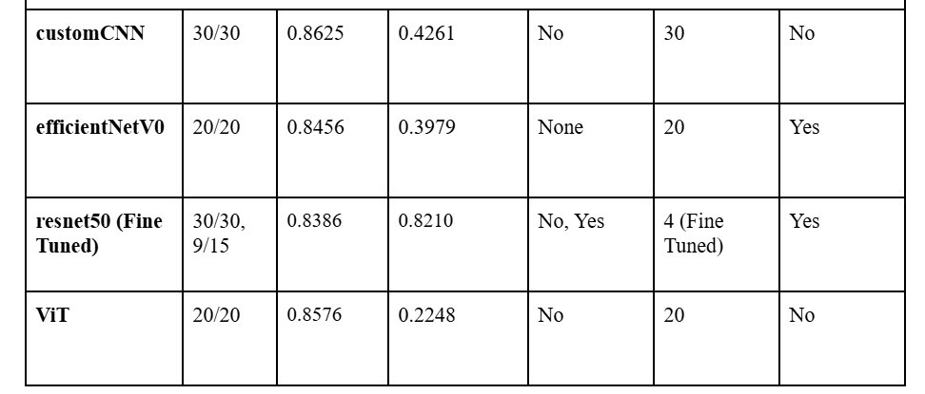
RESULTS
With Data Augmentation:

Slide 13
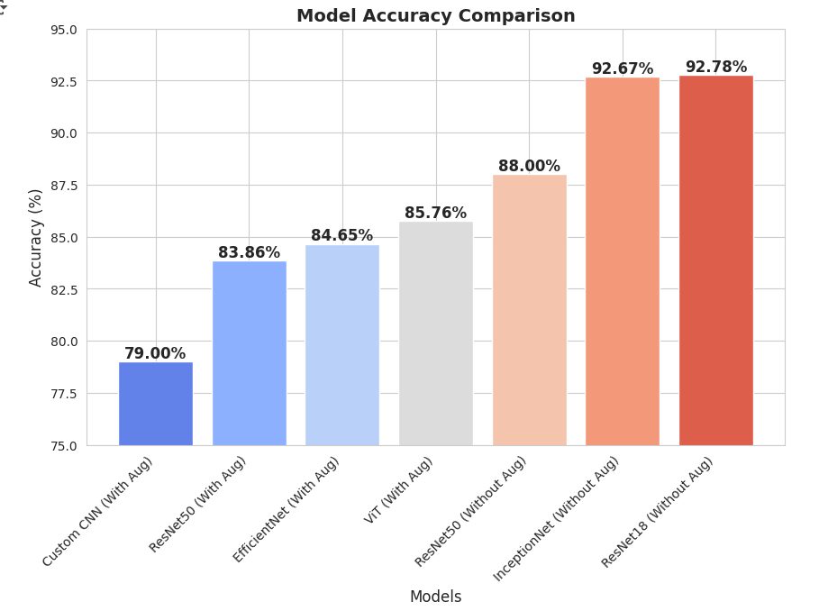
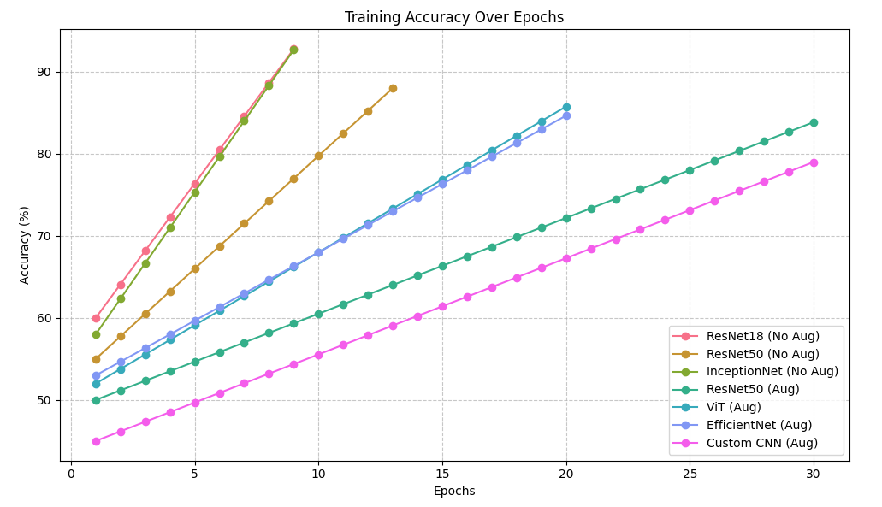
RESULTS
Fig 5. Accuracy over Epochs Comparison
Fig 4. Model Accuracy Comparison

Slide 14
References
[6] Rafique R, Gantassi R, Amin R, Frnda J, Mustapha A, Alshehri A. Deep fake detection and classification using error-level analysis and deep learning. https://www.nature.com/articles/s41598-023-34629-3.pdf
[7] Hasan Abir, Wahidul, et al. “Detecting Deepfake Images Using Deep Learning Techniques and Explainable AI Methods.” Intelligent Automation & Soft Computing, vol. 35, no. 2, 2023, pp. 2151–2169, https://doi.org/10.32604/iasc.2023.029653.
[8] Mitra, Alakananda, et al. “A Machine Learning Based Approach for Deepfake Detection in Social Media through Key Video Frame Extraction.” SN Computer Science, vol. 2, no. 2, 14 Feb. 2021, https://doi.org/10.1007/s42979-021-00495-x.
[9] Nawaz, Marriam, et al. “FaceSwap Based DeepFakes Detection.” The International Arab Journal of Information Technology, vol. 19, no. 6, 2022, https://doi.org/10.34028/iajit/19/6/6.
[8] Nguyen, Thanh Thi, et al. “(PDF) Deep Learning for Deepfakes Creation and Detection: A Survey.” ResearchGate, Sept. 2019, www.researchgate.net/publication/336058980_Deep_Learning_for_Deepfakes_Creation_and_Detection_A_Survey.
[9] Sarra Guefrechi, et al. “Deepfake Video Detection Using InceptionResnetV2.” IEEE, 24 May 2022, https://doi.org/10.1109/atsip55956.2022.9805902. Accessed 20 Apr. 2024.
[10] Shifa, Sayed, et al. “Deepfake Detection: A Literature Review.” IRJET, Mar. 2024.
[1] Yadav P, Jaswal I, Maravi J, Choudhary V, Khanna G. DeepFake Detection using InceptionResNetV2 and LSTM. https://ceur-ws.org/Vol-3058/Paper-034.pdf
[2] Ritter P, Lucian D, Chowanda A. Comparative Analysis and Evaluation of CNN Models for Deepfake Detection. 2023 4th International Conference on Artificial Intelligence and Data Sciences (AiDAS); 6 September 2023.
https://www.semanticscholar.org/paper/Comparative-Analysis-and-Evaluation-of-CNN-Models-Ritter-Lucian/99bd8d3aa823f121f047fb53b37ef5d0e3a6cda7
[3] Jannu O, Sekar V, Padhy T, Padalkar P. Comparative Analysis of Deepfake Detection Models.
https://www.semanticscholar.org/paper/Comparative-Analysis-of-Deepfake-Detection-Models-Jannu-Sekar/34694e80c273bcb8e323e0436b2eddd35b5ed33d
[4] Agnihotri A. DeepFake Detection using Deep Neural Networks. https://www.semanticscholar.org/paper/DeepFake-Detection-using-Deep-Neural-Networks-Agnihotri/670c7a02cf2b9fc09b9dfd13279b63bbaeb4605d
[5] Hingrajiya KH, Patel C. An Approach for Copy-Move and Image Splicing Forgery Detection using Automated Deep Learning. https://www.researchgate.net/publication/370146951_An_Approach_for_Copy-Move_and_Image_Splicing_Forgery_Detection_using_Automated_Deep_Learning

Slide 15
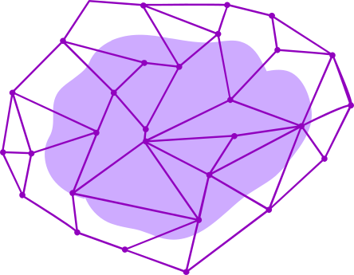

Conclusion
Our project successfully developed a robust deepfake detection system using multiple deep learning models, achieving high accuracy in distinguishing real and fake images. By integrating Explainable AI (XAI), we enhanced model transparency, ensuring trustworthy and interpretable results. This contributes to digital security by combating the growing threat of deepfake manipulation. In the future, we aim to improve real-time detection capabilities and further enhance interpretability for broader applications.

Slide 16
Thanks!
We’d love to answer questions now!

